Slide 1
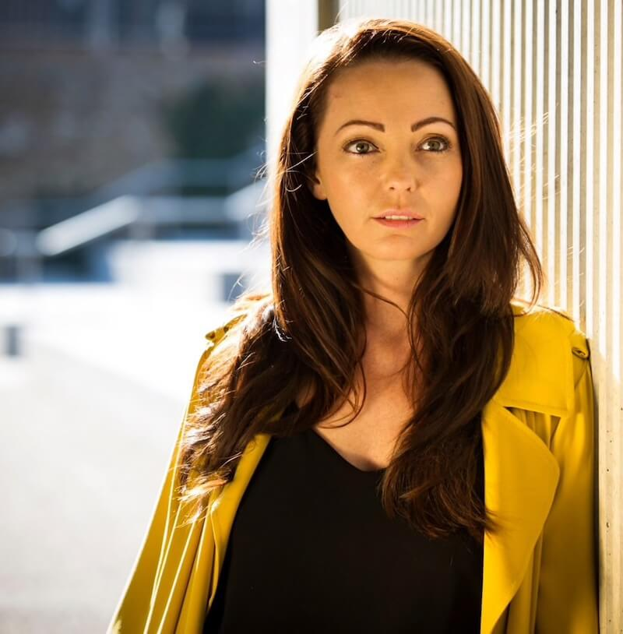
@sammywoodhouse1

Slide 2
SURVIVER OF THE ROTHERHAM CSE SCANDAL
Just A Child
#1 Best Seller
AWARD WINNING CAMPAIGNER | INTERNATIONAL SPEAKER | MEDIA COMMENTATOR

Slide 3
WHAT IS CSE?
A form of sexual abuse, where an individual or a gang, using money and power, exploit children up to the age of 18. This abuse can also be committed online.
Both males and females of all backgrounds can be perpetrators.
Victims can be boys or girls from all backgrounds, ethnicities and religious beliefs. They are groomed into believing they are special, loved and cared for by the perpetrator/s, or their exploitation can be through threats and violence.

Slide 4
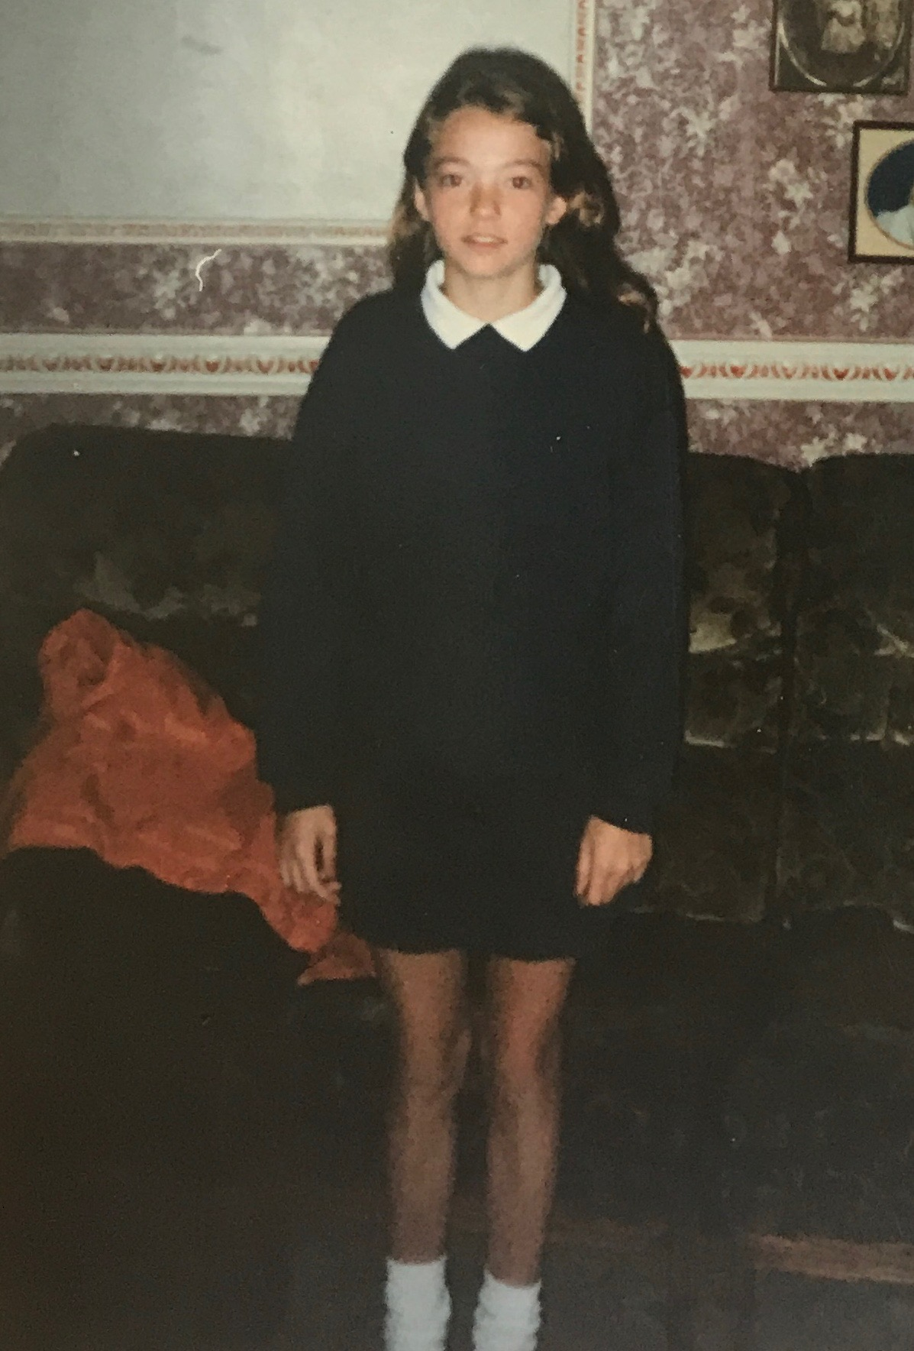
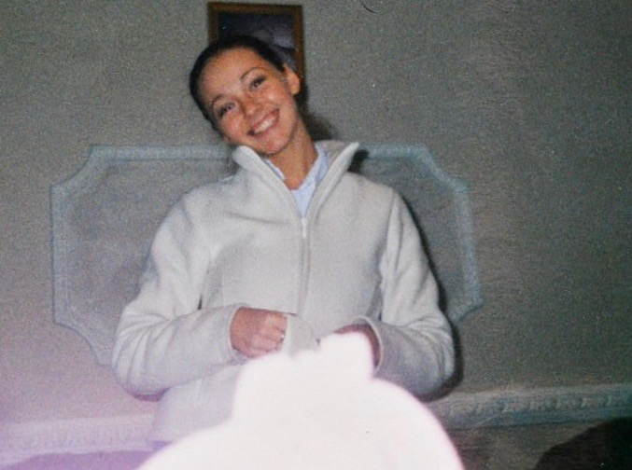
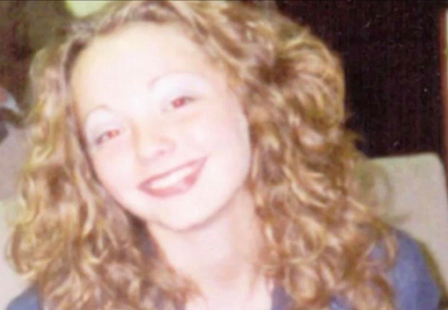

Slide 5
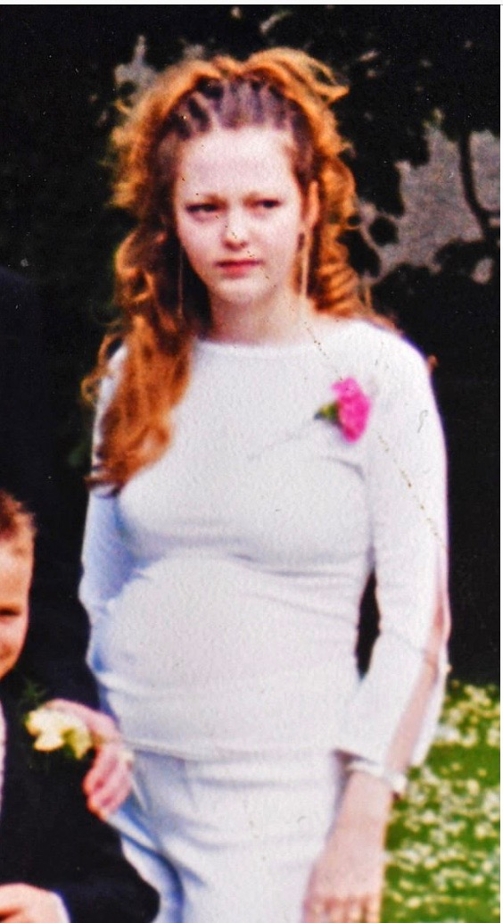
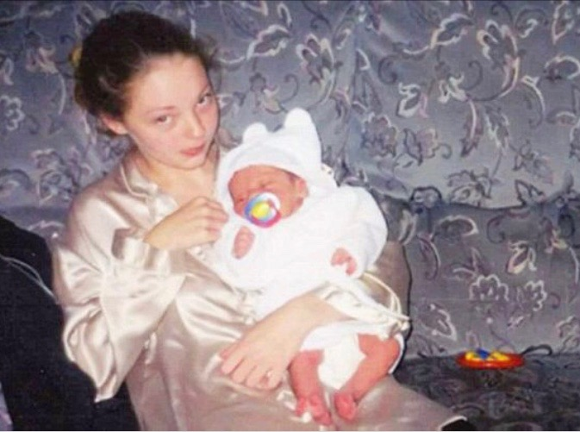
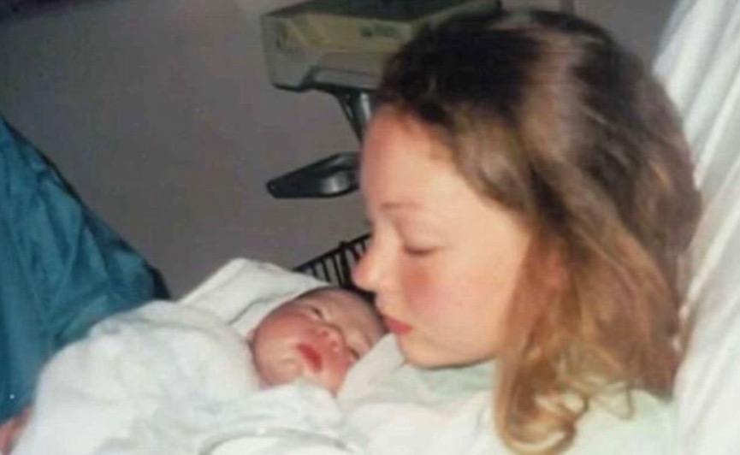

Slide 6
Sageer Hussain received 19 years for CSE offences after this interview

Slide 7
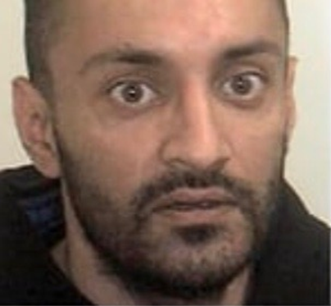
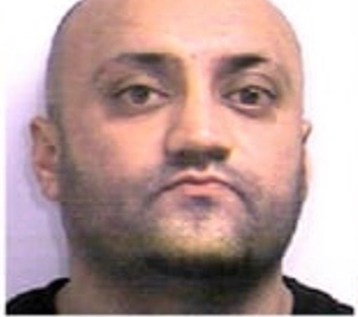
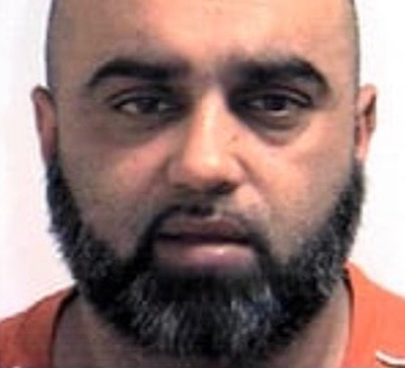
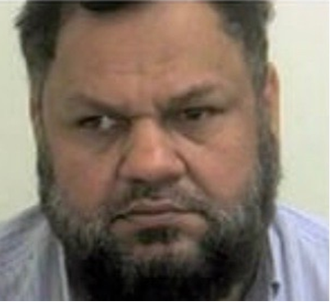
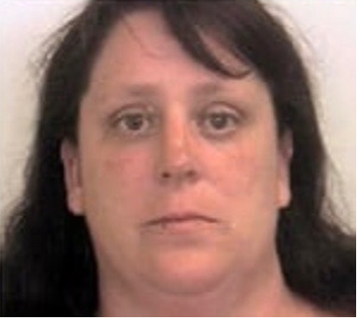
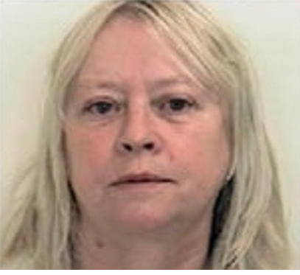
Arshid Hussain ‘Mad Ash’ 35 Years
Basharat Hussain ‘Bash’ 25 Years
Bannaras Hussain ‘Bono’ 19 Years after guilty
Qurban Ali ‘Blind Ash’ 10 Years
Shelley Davies 18 months sentence suspended for 2 years
Karen McGregor ‘Cheque Book Karen’ 13 Years

Slide 8
OPERATION CLOVER & THUNDER
20 OFFENDERS SENTENCED FOR AROUND 300 YEARS, OVER 1500 VICTIMS IDENTIFIED.

Slide 9
CAMPAIGNING
Licensing
Sammy’s law
Cica
Employment
Education
Lap dancing
Funding for support services
Training for all
Family courts
ITV loose women's ‘never too late to tell’ campaign.

Slide 10
VICTIM BLAMING
“I am not satisfied that you were a victim of a sexual assault which you did not in fact consent.”
“I am not satisfied that your consent was falsely given as a result of being groomed by the offender.”
“Because although I understand that in law the offender has committed a crime, in fact it appears that you exercised your choice to engage in sexual activity with the offender.”
- CICA

Slide 11
SPOTTING THE SIGNS
Mood swings - angry, emotional, withdrawn, suicide attempts, depression
Bruising, scarring on body
Receiving gifts
Staying out late or not returning home
Secretive and distant towards family and friends
Skipping education
Involved in criminal activity

Slide 12
SPOTTING THE SIGNS
Education grades dropping
Sexually transmitted infections
Pregnancy or miscarriage
Using alcohol or drugs
Eating disorders
Not sleeping, nightmares, anxiety, panic attacks
Violence or aggression towards parents, siblings or animals

Slide 13
WHY WONT A VICTIM COME FORWARD?
Doesn’t recognise it as abuse
Believe abuser is there girlfriend/boyfriend/think its normal
Too difficult to talk about
Think the abuser will change
Embarrassed, ashamed, judged, to blame, will be rejected, isolated or called a liar

Slide 14
WHY WONT A VICTIM COME FORWARD?
Emotionally attached to the abuser
Feel will put themselves and family at risk
Don’t know who to tell or trust
Be addicted to drugs or alcohol
Committed criminal offences

Slide 15
BUILD A RELATIONSHIP
Understand grooming and abuse, make sure the victim does too.
Use language they relate to.
Be open about your own life experiences, you’re human too but always remain professional.
Suggest a note book/diary to the victim to write memories etc
Focus on building the victims self esteem and confidence. This is about rebuilding their life.
Victims are also groomed to become abusers later on in life. Determine the line of victim or offender.
Don’t pressure, blame, judge. Ask questions, don’t interrogate.
Make sure support is available 24/7 and they are not alone.

Slide 16
BUILD A RELATIONSHIP
Remember not all victims may have told partners, children or families.
Do not be identified to outsiders (police uniforms etc).
Don’t over face victims with too many professionals.
Be prepared for all types of behaviour. Disclosing is very distressing.
Make sure support is in place before, during and after court.
Share the correct info with other services.
Treat child/adult how you would expect your own child to be treated.

Slide 17
EMPOWER/REBUILD LIVES
Help remove self blame, shame, guilt & fear. Its not the victims/survivors to carry, perpetrators feed on victims/survivors living in fear.
Focus on rebuilding the victims self esteem and confidence. This is about rebuilding their life.
Always praise and encourage them to stay positive - they’re strong, brave and can achieve in life. They are not weak, broken or damaged. Tell them to believe in themselves.
Find them a focus/goal - gym, hobbies, college or work.
Survivors don’t just have to survive they can thrive!!!

Slide 18
WHO CAN A VICTIM TALK TO?
Police
Medical professionals
Social services
Teacher or staff
Parent, friend or relative
Confidential helplines

Slide 19
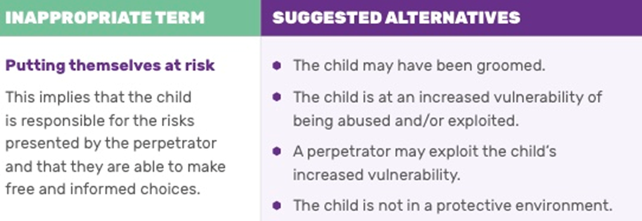
APPROPRIATE LANGUAGE

Slide 31
“Our lives begin to end the day we become silent about things that matter.”
– Martin Luther King Jr

Slide 32
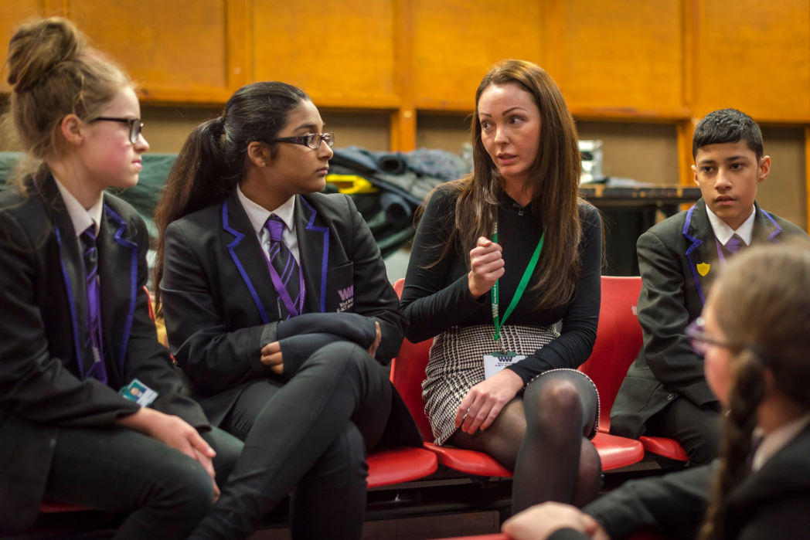
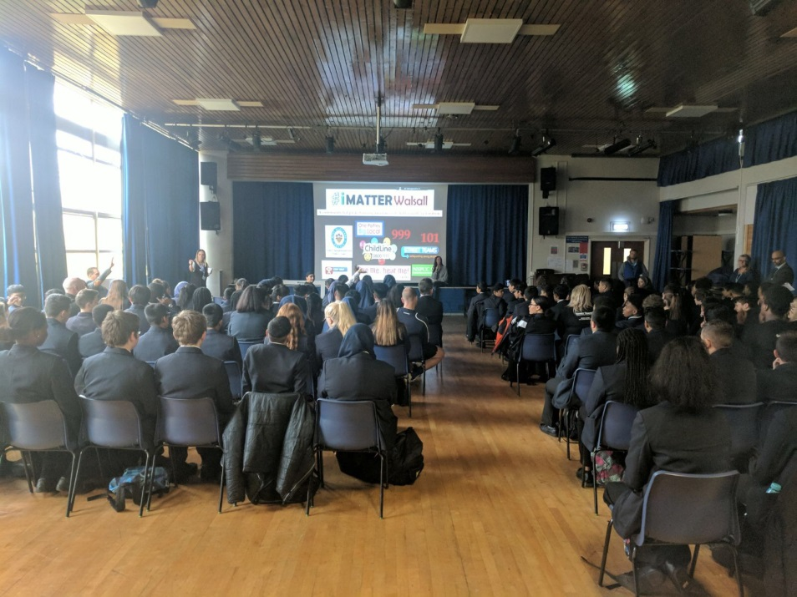
sammywoodhouse.com
twitter.com/sammywoodhouse1
facebook.com/SammyWoodhouse1985
instagram.com/sammywoodhouse/
Sammy Woodhouse
For media and speaking enquiries:
sylvia@tidymanagement.com

