Slide 1

Adverse Childhood Experiences, Resilience and Trauma Informed Care: A Public Health Approach to Understanding & Responding to Adversity
Highland Child Protection Committee ‘Who Sees The Child’
March 2019
Notes:
I am delighted to be here today to and to share the insights from the NHS Highland Director of Public Health Annual Report on Adverse Childhood Experiences and Trauma Informed Care with particular reference to the seeing the child , as well as the baby and teen and identifying and responding to need
I will be summarising some of the key messages in the report and looking at the Family Nurse Partnership in a little more detail
Public Health is interested in what works Or not in relation to population health
Over time and history it has the unenviable task of bringing attention to what is not working Where harm is occurring Where there are risks to health and wellbeing
Often these insights have been against the grain of public thinking
Think of seat belts tobacco and current debates over Equal Protection
We are in the for long haul over changes that are required to make a difference to the health and experience of wellbeing across our populations and the role of services and all of us in creating the necessary change for better outcomes

Slide 2
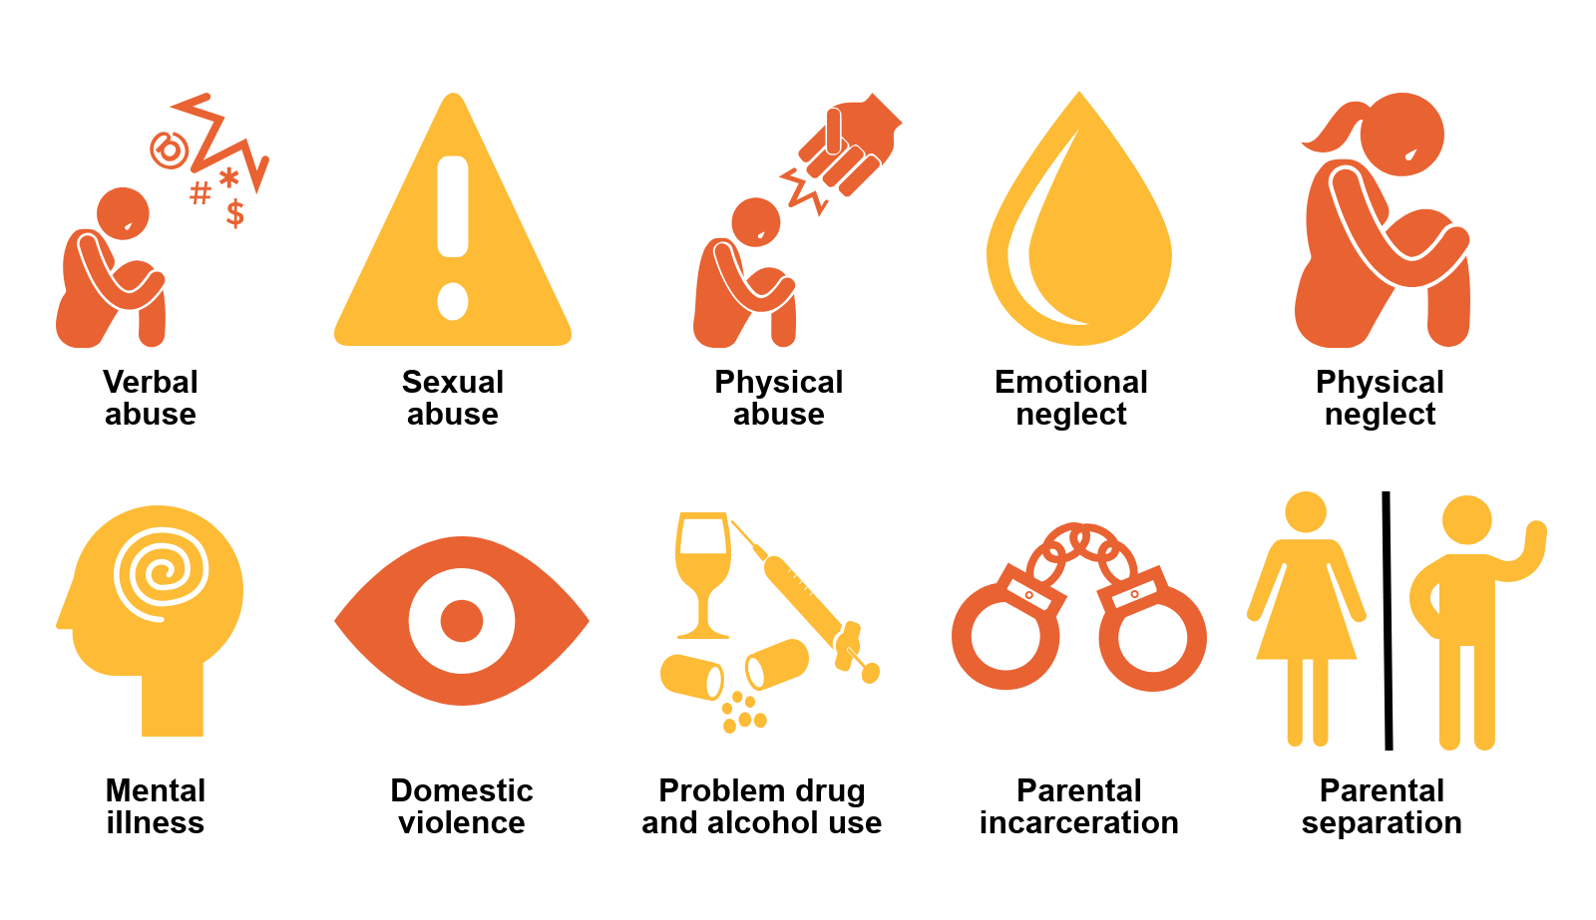
Notes:
I thought I would start with a quick visual to remind us of the 10 sentinel markers of adversity in childhood
Why are these important ?
Because as babies we are born for connection and our sense of self is fundamentally shaped by those early relationships
Family life mediates our wellbeing From the earliest moments of life to our older years
When the needs of parents, however vulnerable they might be, take precedent, the needs of babies and children needs are not or cannot be the priority
How challenging is this for parents and professionals and policy makers?
How do we respond with compassion and insight to ensure good outcomes for all involved?
This seems key to developing trauma informed and trauma responsive systems and services
When our starting point is
What happened to You rather than What’s wrong with you?
We create opportunities to build connection and support resilience that can underpin change and support better outcomes for babies children and young people, their families and the communities they live in

Slide 3
“There should be no shame or stigma in having experienced adversity. If adversity is common, ensuring that individuals, families and communities have the skills and resources to create and support resilience is one of the key messages from this report”
Director of Public Health Annual Report 2018.
Notes:
Within the report we were clear that adversity is common and more so than might have been realised
That while experiences of adversity shape us They need not define us
This is particularly the case when our struggling/suffering is recognised Validated and met with compassion and insight as to why this is so
This creates the necessary space to reflect and make sense of what has shaped but need not define us
I say this with parents and their children in mind
If we are to be genuine and effective in our understanding and response to adversity in childhood our starting point has to involve the awareness and understanding that there should be........

Slide 4
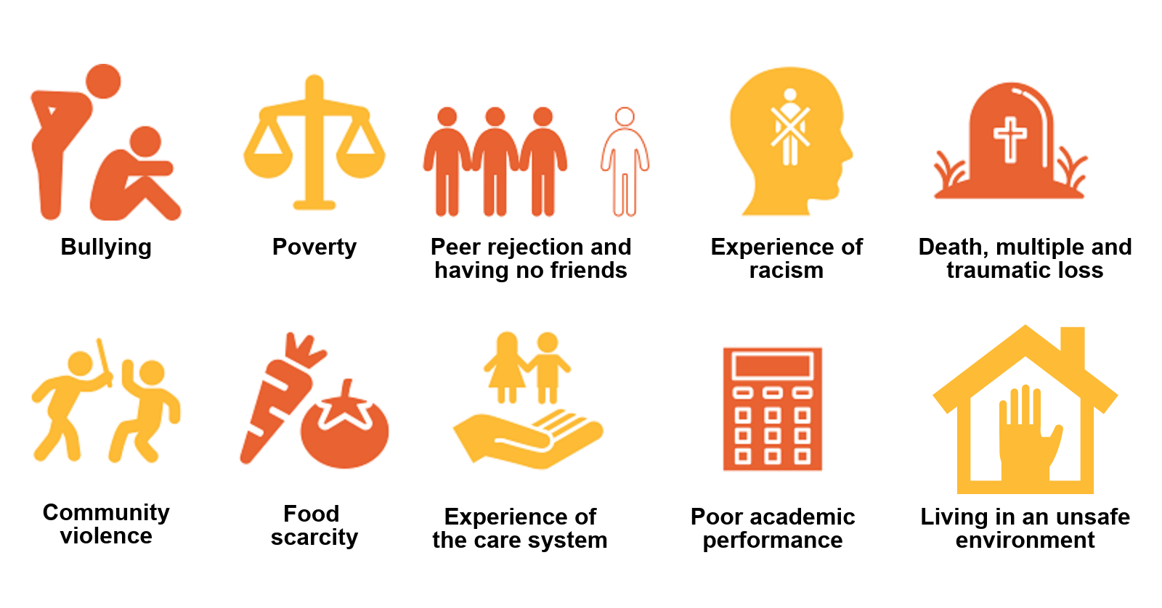
Notes:
As well as those ten sentinel population markers in the home there a range of other factors that reflect the types of adversity that can impact on our wellbeing as demonstrated in this slide
Lack of structural safety
Can impact on relational safety
Exacerbated by lack of community safety
One of the outputs from the debates over adverse childhood experiences is that increased awareness of how much better we do when we experience relational and environmental safety
Be that in our homes, wider networks of family and friends and our communities

Slide 5
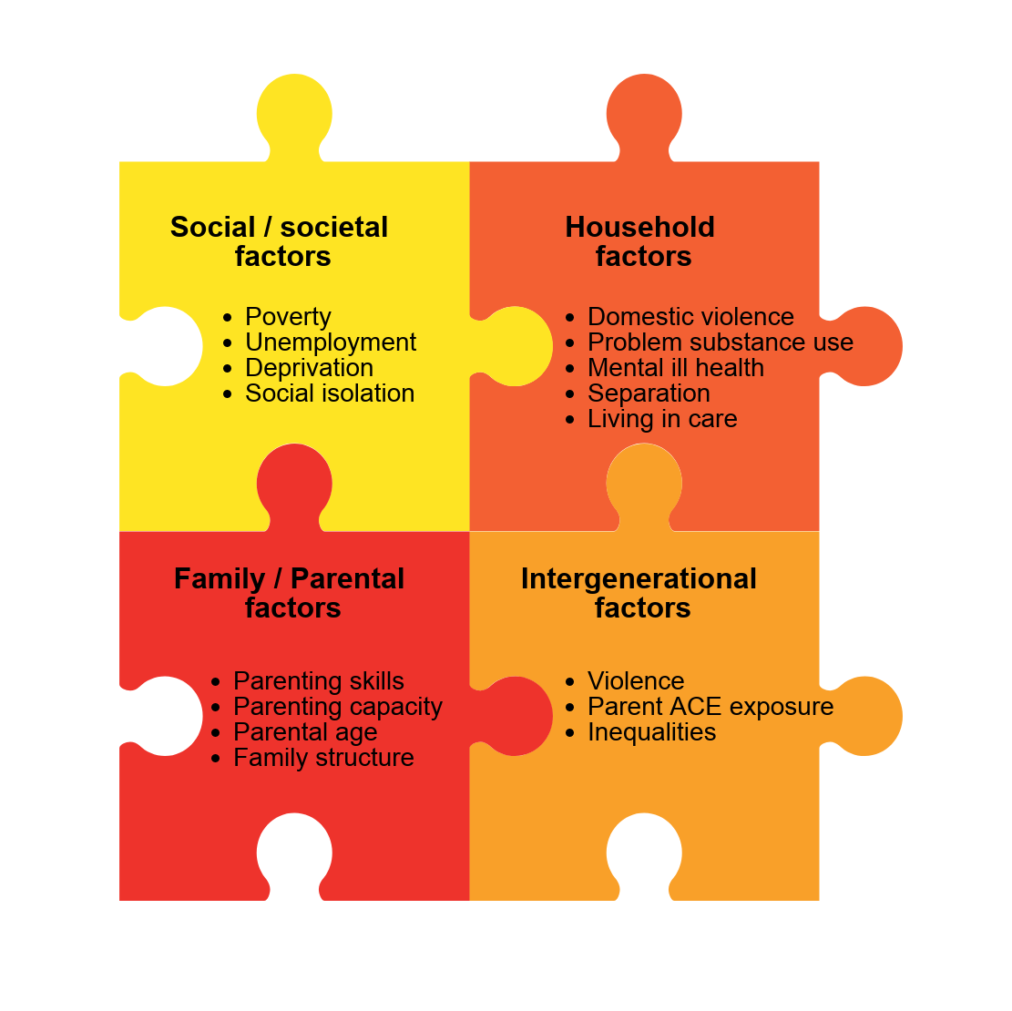
Notes:
A key point in the report is that the risk factors for adversity are often co occurring and inter linked
It is usually the cumulative effects of a combination of factors, rather than a single issue that leads to a child’s experience of adversity and stress and these can influence the needs of babies children and young people to have a safe buffering adult to offset the effect of escalating stress
This is demonstrated in the inter locking model created for the DPH Report
A series of interacting risk factors for adverse childhood experiences include
Social context
Parenting
Family structure
Household factors

Slide 6
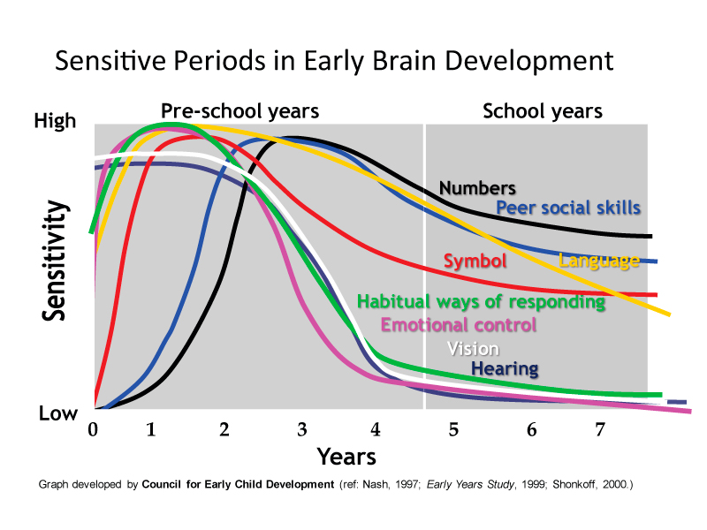
Notes:
I have used this graphic to demonstrate the importance of those very early moments in life that present the greatest opportunities to make a difference
The primacy of the first 1001 days from conception to toddlerhood, in laying the basis for health across a life trajectory has yet to be fully appreciated in public spending priorities with longitudinal studies now demonstrating a relationships between experiences of abuse in childhood and adult mental health experiences
When a baby’s development falls behind the first year of life it is much more likely to fall even further behind in subsequent years than to catch up with those who had a better start
While some children can catch up, there might still be a legacy effect with regard to learning and behaviour, influencing their experience of school, learning and life chances and employability
Adversity in the early years and through to adolescence has a bigger impact than has previously been understood

Slide 7
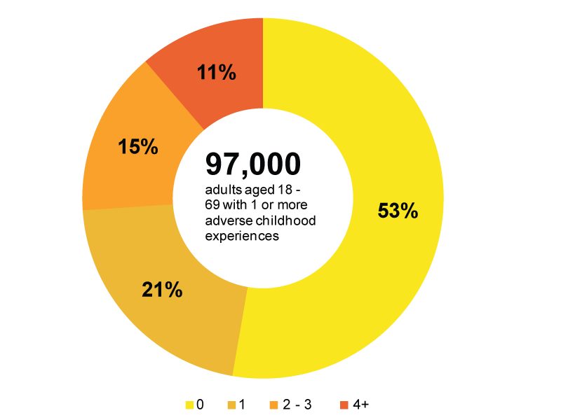
Notes:
Population prevalence data from England and Wales was used in the report to determine the influence of adversity in the Highland population
Some 53% of adults will have experienced 1 of the ten sentinel markers
11 out of 100 adults will have experience of more than 4
These individuals living with an increased risk of poorer physical health experiences, health harming behaviours and mental health and substance misuse difficulties
Many of these adults will be parents or likely to become parents
And while we would recognise that experience of adversity does not equate directly to poor outcomes we cannot escape the relationship and the impact

Slide 8
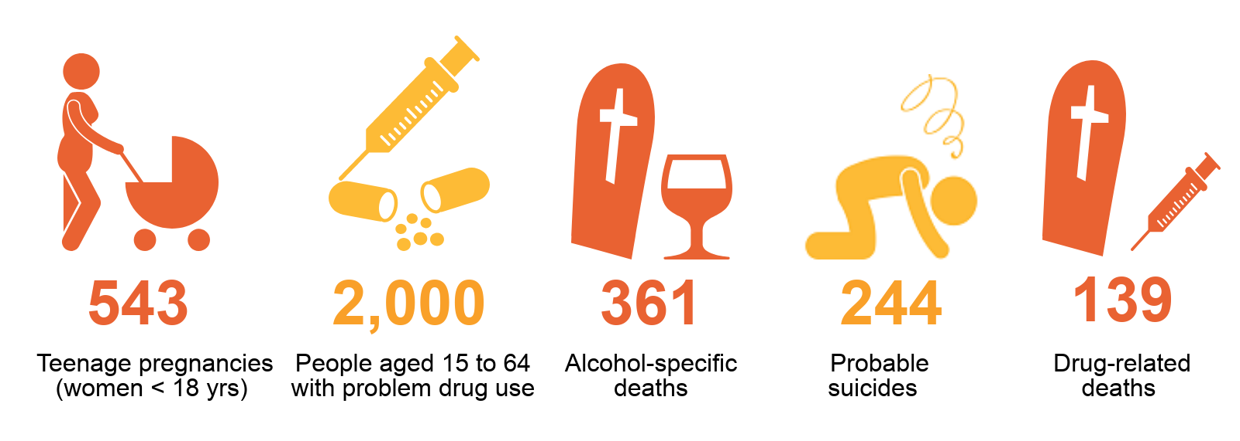
Notes:
In the report we detail how experience of multiple adversity is likely to feature over the last five years in Highland
Teen pregnancy
Drug and alcohol misuse
Alcohol specific deaths
Probable suicides
Drug related deaths (over 30 in the last year alone) and in increase of younger ages over recent years
This is the front end of human suffering that undoubtedly impacts on the safety and well being of babies children and young people

Slide 9
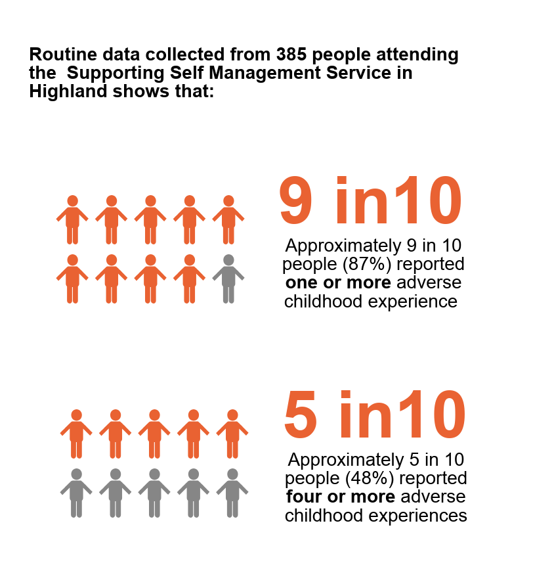
5.8x
10x
more likely to develop problematic alcohol use
more likely to develop problematic drug use
6.1x
14x
15x
more likely to receive treatment for mental illness
more likely to be a victim of violence
More likely to be a perpetrator of violence
Notes:
It is understood from the population research that these eleven out of one hundred adults are at greater risks of a range of health outcomes that compromise our health and wellbeing
Mental illness
Substance misuse
Alcohol misuse
Inter personal violence
Local data collected by Dr Tim Agnew Consultant Psychiatrist for the Personality Disorder Service suggests such a relationship with 9 out of 10 people referred reporting one experience of those sentinel markers and 5 in 10 more than 4.
Recall for the general population this would be 5 in 10 and 1 in 10
Exploring the scale influence and impact of adversity and how to best respond seems a useful lens to understand human suffering
Colleagues in the room working in mental health services, drug and alcohol services and the police/community justice sector will be working with clients and service users where it is likely that experience of trauma is implicated in there need of, or involvement with services
Colleagues working with families in universal services for children and families, midwifery, health visiting , education and in communities might also be seeing and recognising the links between experience of adversity and the challenges in the lives of people that influence parenting styles and capacity and managing the day to day
As the previous slides made clear, relationships across life and in a range of settings from home, to school work and community are key to offsetting the effect of adversity
A trauma informed and trauma responsive approach seeks to respond in the moment to needs as they present as well as working preventively in the early years, across generations and with families.

Slide 10
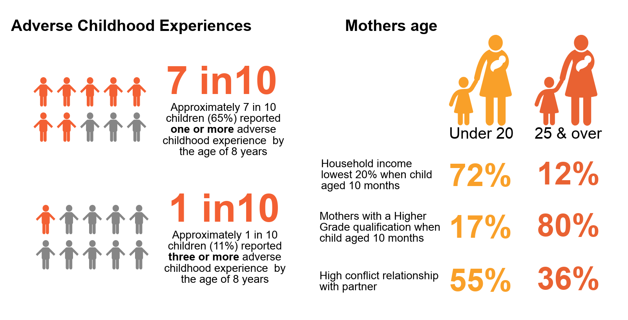
Notes:
Population studies of pregnant women have suggested that 4 put of 10 women have experience of more than one adverse childhood experience
Published data from the Growing Up in Scotland study has found that 7 in 10 children had experience of one of the sentinel markers and almost 1 in five more than 4
Set against wider adversity with regard to lower household income, fewer academic qualifications and higher levels of relationship conflict
Data collected for the Highland FNP service covering Inverness and the Inner Moray Firth indicates 7 in 10 young women have experienced 1
Nearly 2 in 10 have experience more than 4
The strength based approach in the Family Nurse Partnership is seen as key
The development of a therapeutic relationship brings a positive role model: that buffering adult that might not have been readily available before
This creates and supports resilience and related decision making to ensure better outcomes for both mum and baby Often with Dads and wider family members involved too
Key to the success of the programme is the reflective and restorative supervision to the teams Prompting and supporting front facing practice
This should be the standard and the norm for working with families experiencing multiple adversity and we are a long way from demonstrating this in our spend across services

Slide 11
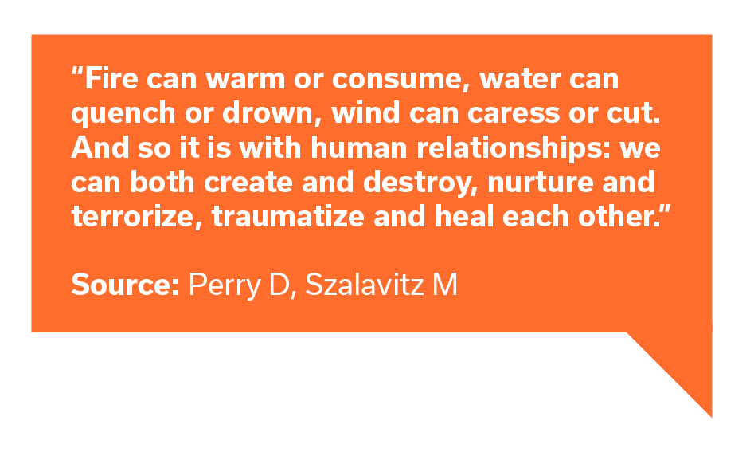
Notes:
This is a quick flick through the report with some key messages for today’s focus on seeing the child
We learnt a lot within the public team while writing the report
A key element of the learning was of the power of relationships to do good and also a risk of harm
When we can embrace what Jung called the shadow of our selves and experiences as individuals and communities/societies we get closer to healing and resolution and moving ahead from a position of strength
This is why we need to pause and understand what drives and perpetuates adversity in childhood
And get better at understanding how a response of What happened to you brings opportunities that we have yet to exploit in full

Slide 12
DPH Annual Report Adverse Childhood Experiences Resilience and Trauma Informed Care A Public Health Approach:
Main Report
nhshighland.scot.nhs.uk/Publications/D…
Summary
spark.adobe.com/page/JuNx7xNpy…
Twitter @AceHighland

